Slide 1
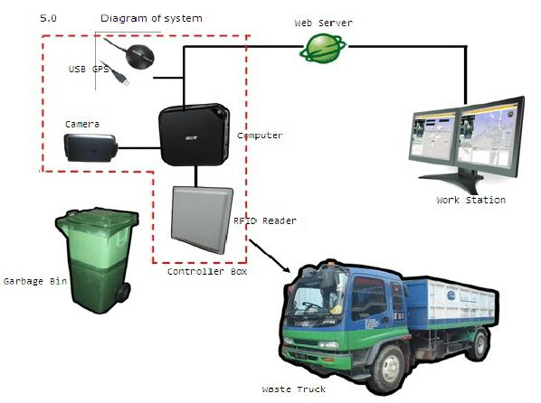

Slide 2
Iot based Smart waste management system of metropolitan cities
Waste bins are part of our lives for decades and mostly its condition are overflowing due to improper waste dumping, collection and management, which leads in foul smell and unhygienic condition, thus inherently results in environment pollution. Therefore, in this paper, design of a Waste Bin with real time monitoring is presented and a smart was.
This project deals with the problem of waste management in smart cities, where the garbage collection system is not optimized. This project enables the organizations to meet their needs of smart garbage management systems

